Slide 1
P10 Cracking the Code Scenario Solution
A113 – Mathematics

Slide 2
Cracking the Code: Code 1
There are 3 cards (red, green and blue). These cards have to be inserted into the 3 card slots in the correct arrangement.
There are a lot of possible variations to arrange the 3 cards of different colours.
We will make use of the tree diagram to help us find the number of possible variations.
…

Slide 3
Cracking the Code: Code 1
3
?
?
Slot 1
Slot 2
Slot 3
R
Initial Point
G
B
To place a card in Slot 1, we have 3 choices. Thus, 3 branches can be extended from the initial point.

Slide 4
Cracking the Code: Code 1
3
2
?
Slot 1
Slot 2
Slot 3
G
R
B
Initial Point
G
Same for the other 2 branches.
B
To place a card in Slot 2, we are left with 2 choices. Thus, for each branch in Slot 1, we can extend out another 2 branches.
.

Slide 5
Cracking the Code: Code 1
3
2
1
Slot 1
Slot 2
Slot 3
G
B
R
B
Same for the other 1 branch.
Initial Point
G
Same for the other 2 branches.
B
Finally, to place a card in Slot 3, we are left with 1 choice. Thus, for each branch in Slot 2, we can extend out another 1 branch.

Slide 6
Cracking the Code: Code 1
Total number of ways to arrange the 3 cards
3
×
2
×
1
=
= 3! = 6
Slot 1
Slot 2
Slot 3
G
B
R
B
Same for the other 1 branch.
Initial Point
G
Same for the other 2 branches.
B

Slide 7
Cracking the Code: Code 2
There are 9 buttons on the electronic keypad. Each time a button is pressed, the letter lights up and the button cannot be pressed again. 4 buttons need to be pressed in the correct combination.
The order in which the buttons are pressed does not matter.
A
B
C
A
B
C
A
B
C
…
D
E
F
D
E
F
D
E
F
G
H
I
G
H
I
G
H
I
Total number of ways to press a 4 letter combination out of the 9 button keypad
= ⁹C₄ = 126

Slide 8
Cracking the Code: Code 1 & Code 2
Number of ways to execute Code 1 = 6
Number of ways to execute Code 2 = 126
Number of ways to execute Code 1 and Code 2 =
The time required to execute each set of Code 1 and Code 2 together is 10 seconds.
Time required to execute all possible sets of Code 1 and Code 2
= seconds
= 7560 seconds
= 2.1 hours
Since 2.1 hours < 3 hours, the police should attempt to crack the code.

Slide 9


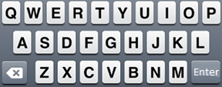
Exploring Further – New Code
The new code to deactivate the bomb now requires the user to enter a password.
The password is made up of 2 capital letters and 1 number.
Passwords with repeated letters are valid as well.
The time required to enter each password is 1 second.
Enter Password
_ | _ | _

Slide 10
Exploring Further – New Code
There are 3 possible formats of the password formed using 2 letters and 1 number:
Letter, Letter, Number
Letter, Number, Letter
Number, Letter, Letter
Let us compute the number of ways to form the password for each format.

Slide 11
Exploring Further – New Code
Letter, Letter, Number:
Number of ways to form the password
Letter, Number, Letter:
Number of ways to form the password
Number, Letter, Letter:
Number of ways to form the password

Slide 12
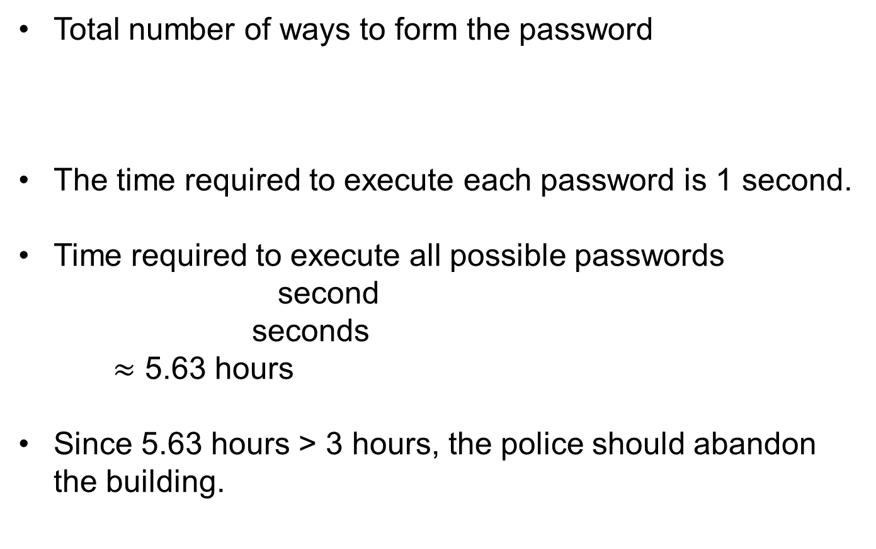
Exploring Further – New Code
Total number of ways to form the password
The time required to execute each password is 1 second.
Time required to execute all possible passwords
second
seconds
$≈$ 5.63 hours
Since 5.63 hours > 3 hours, the police should abandon the building.

